Slide 1
Lab #4
Communication Subsystem

Slide 2
Intro
In this lab, you will build KestrelSAT's communication system including the onboard radio and ground station with dipole antenna.
You will test communication and measure signal strength at multiple link distances to characterize the link budget and determine if KestrelSAT has sufficient link margin to communicate from orbit.
A laptop will serve as the ground station for KestrelSAT. The ground station computer will send commands to the spacecraft over an XBee wireless serial link.
Authorized Resources – LAB
Lab activities are team effort
Any non-human resource
Generative AI Level 3 Allowed
Astro 331 course notes/instructor
Intro
KestrelSAT
Reference
Prelab
Task 1
Task 2
Task 3
Task 4
Turn-in Reqt’s
Authorized Resources - POSTLAB
Postlab turn-in is individual effort
Generative AI Level 0 Allowed (GenAI not allowed)
Astro 331 course notes/ instructor
Objectives:
Understand fundamentals of Satellite communication via practical experimentation.
Demonstrate point-to-point communication by sending telemetry packets from a “satellite” node to a “ground station” node.
Evaluate link quality by observing RSSI (Received Signal Strength Indicator).
Apply link budget concepts qualitatively by relating transmission power, antenna gain, and range to observed performance.

Slide 3
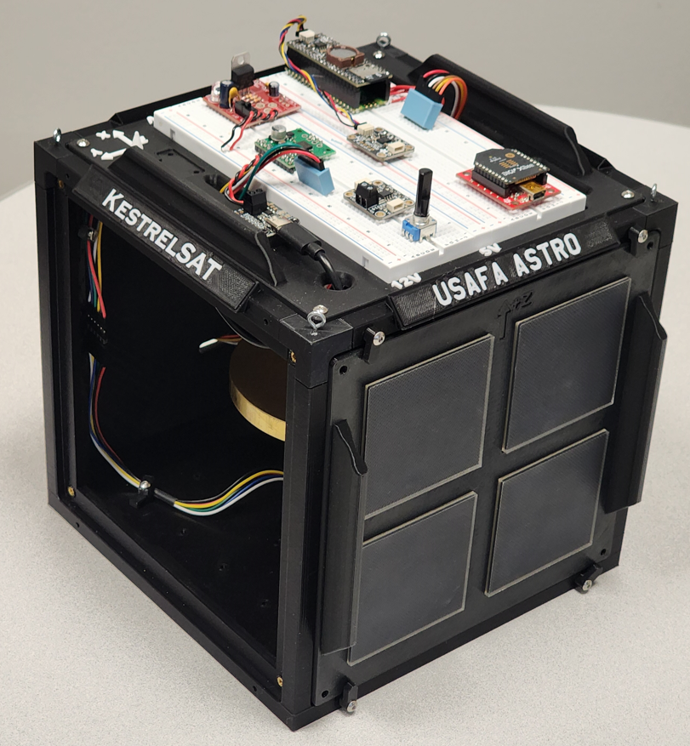
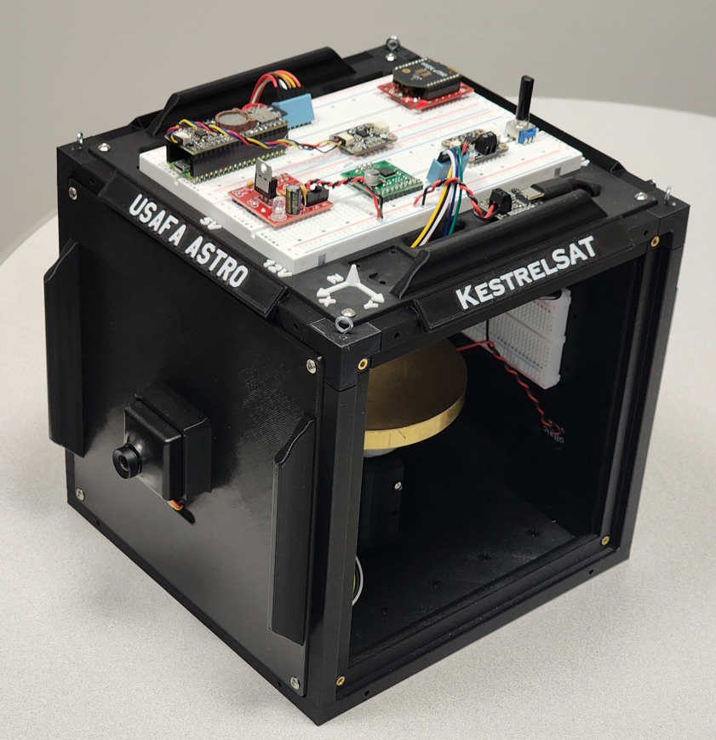
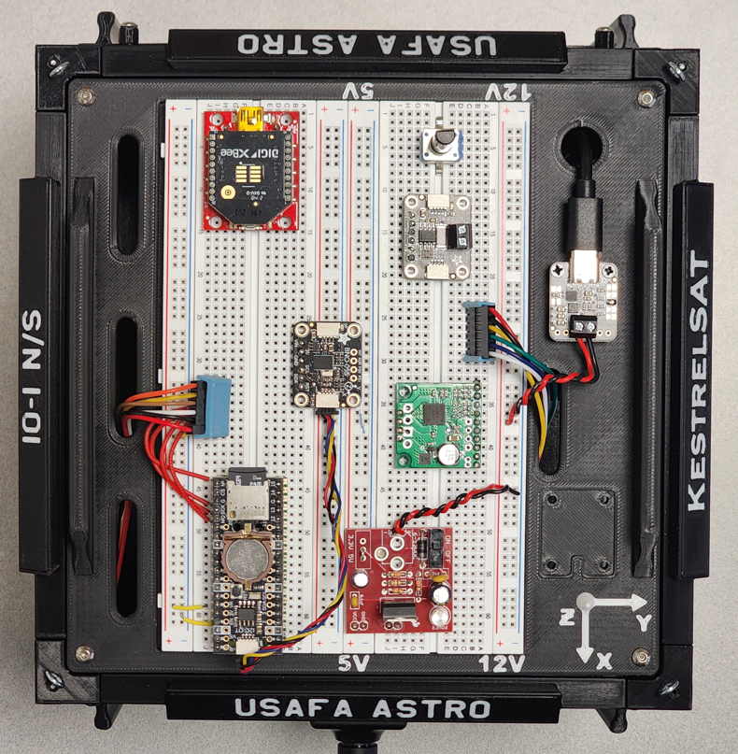
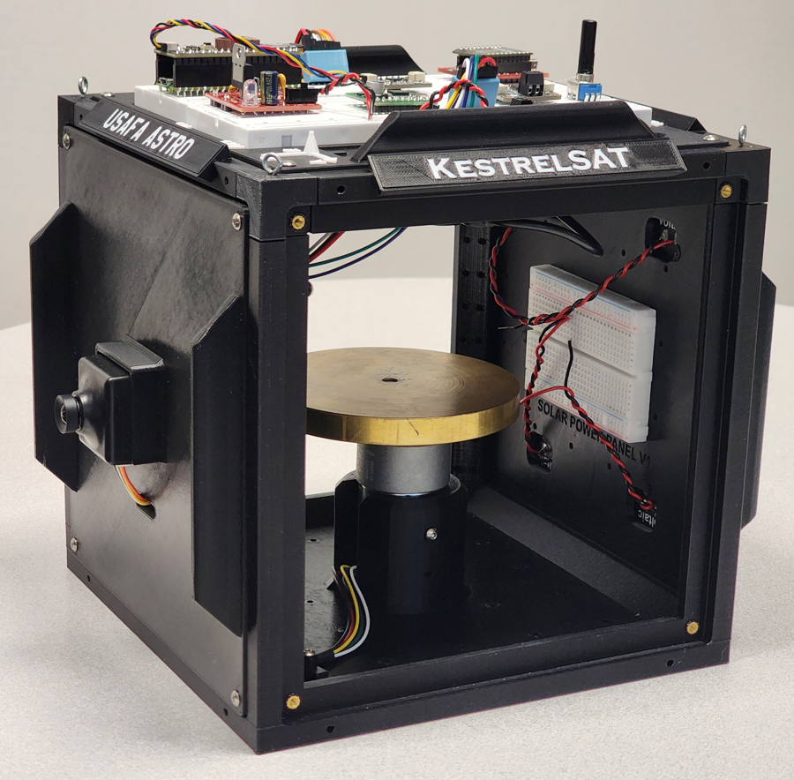
KestrelSAT Overview
Intro
KestrelSAT
Reference
Task 1
Task 2
Task 3
Task 4
Task 5
Turn-in Reqt’s
Solar Power Side
Reaction Wheel
Camera Side
Solar Power
V & I Sensor
Comm (Xbee transceiver)
Battery Controller
IMU (BNO055)
Motor Driver
MCU (Rpi Pico)
Memory (SD)
Real-Time Clock
12V DC to 5V DC Regulator

Slide 4
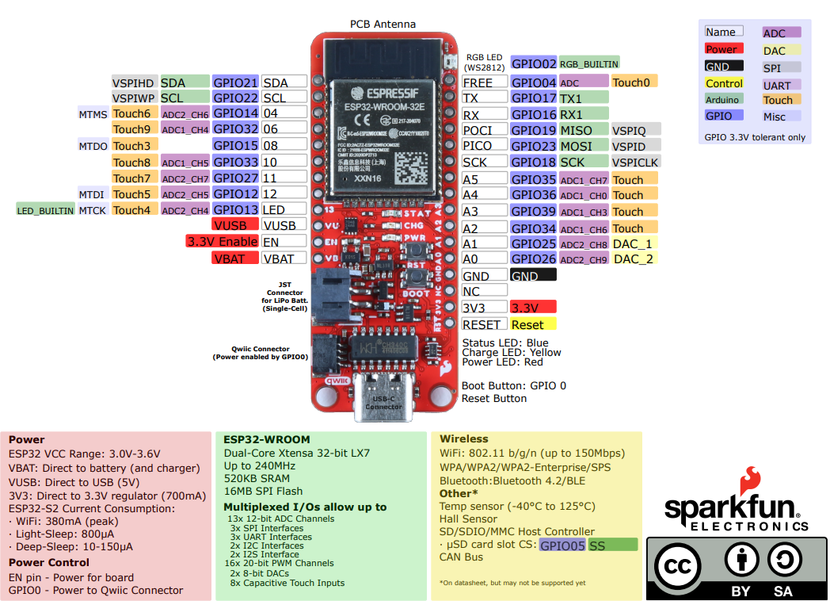
ESP32 Thing Plus Pinout Diagram
Intro
Reference
Task 1
Task 2
Task 3
Task 4
Task 5
Turn-in Reqt’s

Slide 5
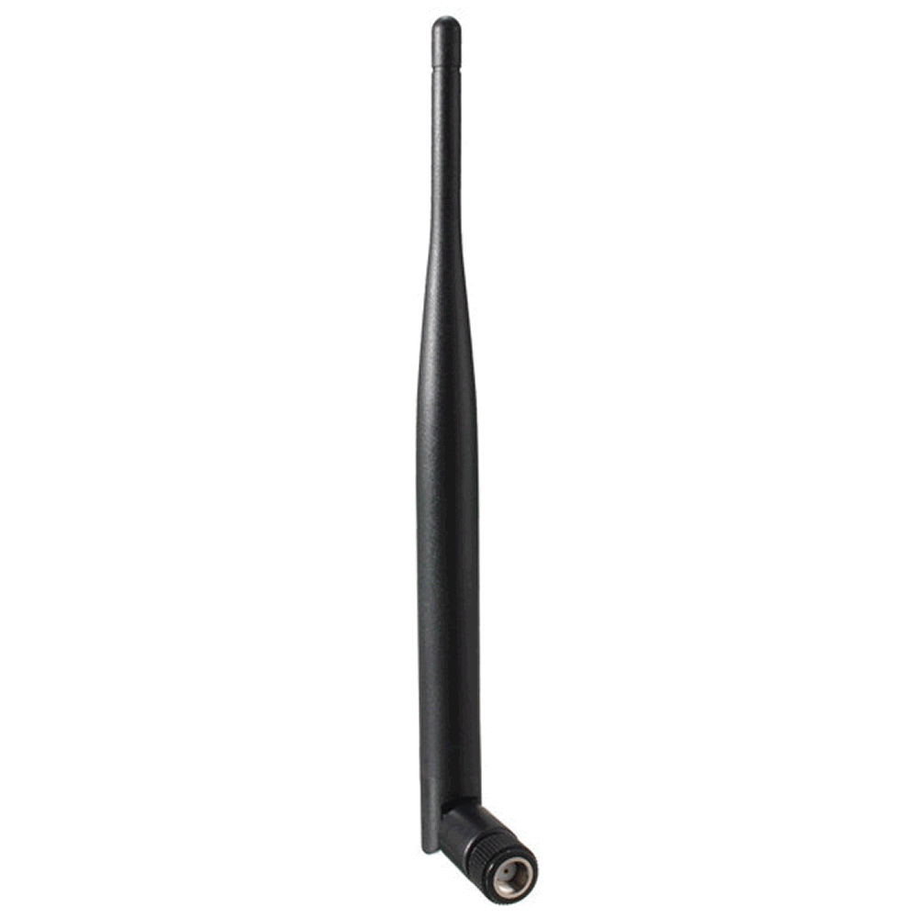
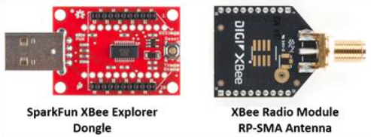
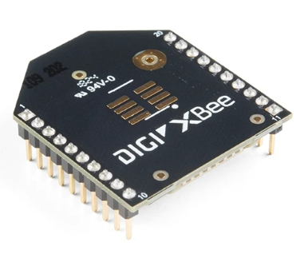
Reference – Digi Xbee3
Intro
Reference
Task 1
Task 2
Task 3
Task 4
Task 5
Turn-in Reqt’s
XBee is a family of wireless communication modules made by Digi International.
In this lab we will use Series 3 modules, which operate at 2.4 GHz (why might this be a problem in a lab setting?)
XBees are transceivers (they can both transmit and receive data).
They are available in different models capable of using different types of antennas.
Datasheet
Xbee Radio Module with PCB Antenna
Dipole Antenna

Slide 6
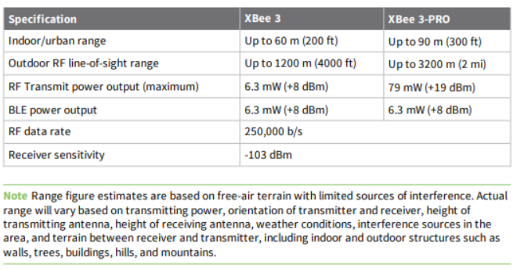
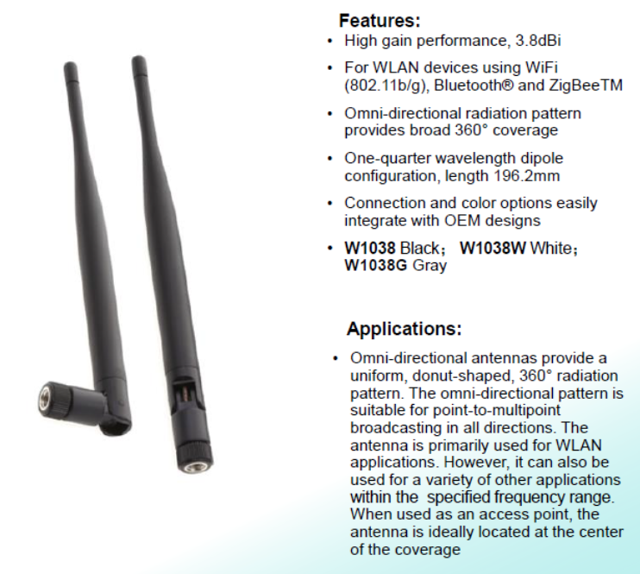
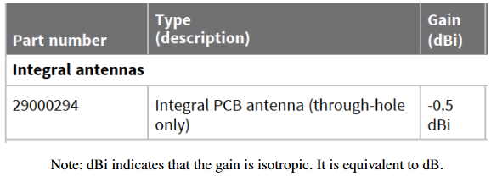
Reference – Digi Xbee3 Performance Specs
Xbee3 Radio Module Performance Specifications:
Intro
Reference
Task 1
Task 2
Task 3
Task 4
Task 5
Turn-in Reqt’s
Dipole Antenna Gain:
Xbee3 Radio PCB Antenna Gain:

Slide 7
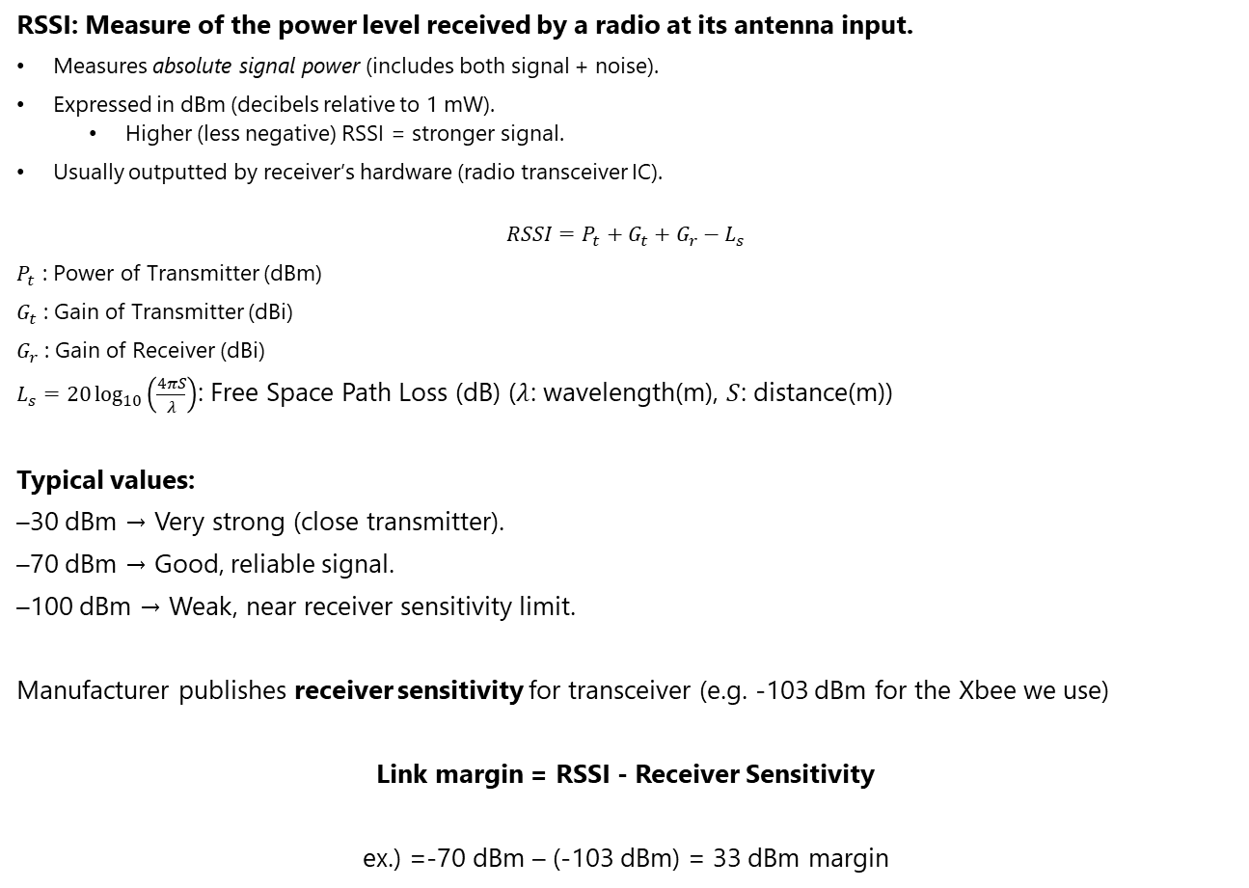
Reference – Received Signal Strength Indicator (RSSI)
Intro
Reference
Task 1
Task 2
Task 3
Task 4
Task 5
Turn-in Reqt’s
RSSI: Measure of the power level received by a radio at its antenna input.
Measures absolute signal power (includes both signal + noise).
Expressed in dBm (decibels relative to 1 mW).
Higher (less negative) RSSI = stronger signal.
Usually outputted by receiver’s hardware (radio transceiver IC).
$$RSSI=P_{t}+G_{t}+G_{r}−L_{s}$$
$P_{t}$ : Power of Transmitter (dBm)
$G_{t}$ : Gain of Transmitter (dBi)
$G_{r}$ : Gain of Receiver (dBi)
$L_{s}=20\log_{10}\left(\frac{4πS}{λ}\right)$: Free Space Path Loss (dB) ($λ$: wavelength(m), $S$: distance(m))
Typical values:
–30 dBm → Very strong (close transmitter).
–70 dBm → Good, reliable signal.
–100 dBm → Weak, near receiver sensitivity limit.
Manufacturer publishes receiver sensitivity for transceiver (e.g. -103 dBm for the Xbee we use)
Link margin = RSSI - Receiver Sensitivity
ex.) =-70 dBm – (-103 dBm) = 33 dBm margin

Slide 8
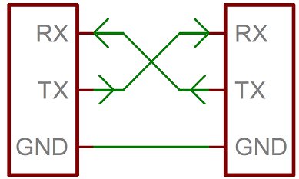
Reference – Serial Communication
Serial communication is the process of sending data one bit at a time, sequentially, over a communication channel or computer bus.
Two types of serial communication:
Asynchronous serial (most common in microcontrollers → Arduino Serial):
This basic serial bus consists of just two wires - one for sending data (AKA transmitting or TX) and another for receiving (AKA RX).
No shared clock line.
Instead, both sides agree on a baud rate (bits per second, e.g., 9600 bps).
Data framed with start bit, data bits, optional parity bit, stop bit(s).
Synchronous serial (SPI, I2C):
Uses a shared clock line.
Faster and often used for sensor-to-MCU communication.
Intro
Reference
Task 1
Task 2
Task 3
Task 4
Task 5
Turn-in Reqt’s
Tutorial
Device 1
Device 2
Universal Asynchronous Receiver/Transmitter (UART)

Slide 9
Reference – KestrelSAT Xbee Communication
Intro
Reference
Task 1
Task 2
Task 3
Task 4
Task 5
Turn-in Reqt’s
In this lab, an XBee to XBee link will act as a wireless serial connection.
Ground-to-KestrelSAT communication:
The radios need to be programmed with compatible parameters (channel, etc.) before they can communicate (see Digi XCTU slide).
After receiving a command, KestrelSAT will produce a response and return it to the ground station using the same link in reverse.
Each XBee radio maintains a record of the signal strength of the last message it received. An RSSI query from the ground station involves the following steps:
Query message from ground station via XBee to KestrelSAT
MCU asks KestrelSAT XBee for RSSI
KestrelSAT XBee responds in hex format
MCU converts response to ASCII decimal format
MCU sends RSSI string via XBee to ground station
USB
UART Serial (TX/RX wires)
Laptop Serial Terminal (PuTTY)
Ground Station XBee
KestrelSAT XBee
KestrelSAT MCU
2.4 GHz Wireless

Slide 10

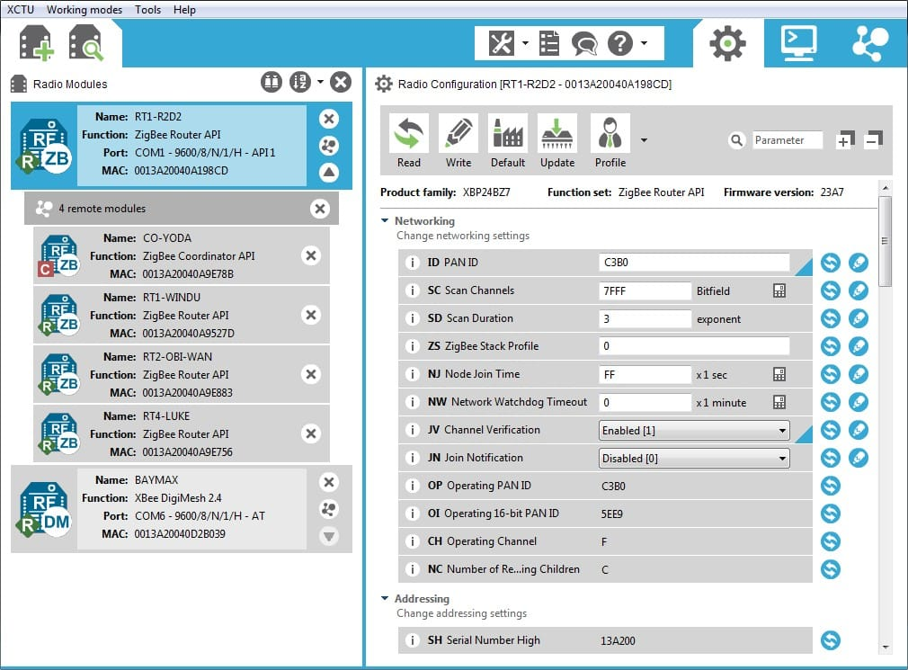

Reference – Digi XCTU
Intro
Reference
Task 1
Task 2
Task 3
Task 4
Task 5
Turn-in Reqt’s
XCTU is a desktop configuration and diagnostic utility used to work with XBee radios and related RF modules made by Digi International.
In this lab we’ll use it to configure our XBee devices over USB.
It can also be used to test and manage Xbee networks.
https://www.digi.com/products/embedded-systems/digi-xbee/digi-xbee-tools/xctu

Slide 11
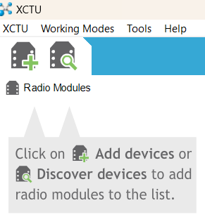
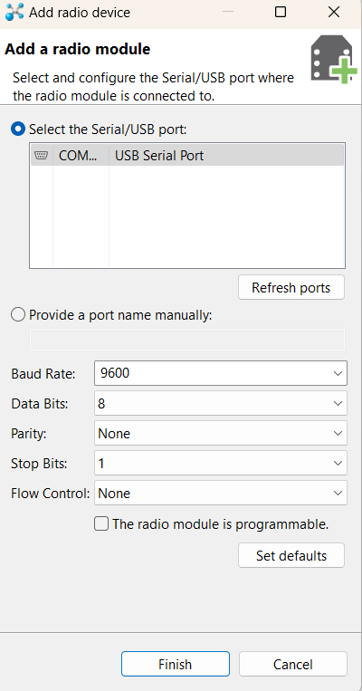
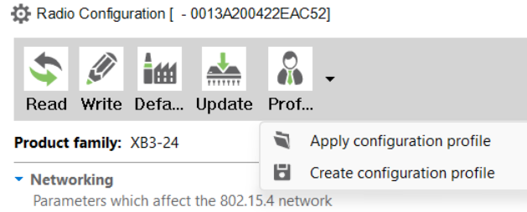
Task 1 (1/2) – Configure XBee Radios
In this task you’ll pair your radios. Your radios must be configured with matching parameters.
Configure three radios:
One ‘Ground Station’ radio with dipole antenna.
One ‘Ground Station’ radio with PCB antenna
One ‘KestrelSAT’ radio with dipole antenna
Intro
Reference
Task 1
Task 2
Task 3
Task 4
Task 5
Turn-in Reqt’s
Install XCTU from here or .exe file provided by your instructor.
Plug in XBee and carrier board into your computer.
Open XCTU and connect to the Xbee.
Select the Xbee from the left panel to show its settings.
Click the dropdown next to Profile and select “Apply configuration profile”.
Load “KestrelSAT_omni_profile_2014.xpro” (this file is available on Teams or from Instructor)

Slide 12
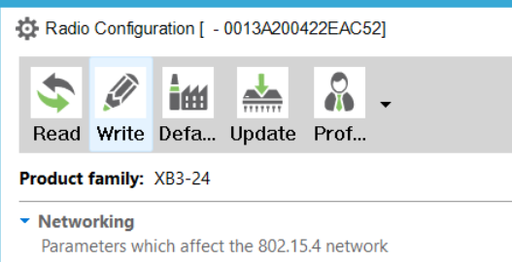
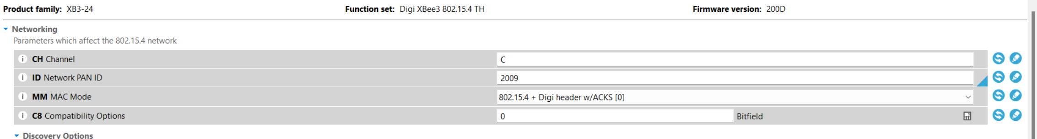
Task 1 (2/2) – Configure XBee Radios
Intro
Reference
Task 1
Task 2
Task 3
Task 4
Task 5
Turn-in Reqt’s
The only setting you need to change is the ID Network Pan ID. This is a four-digit number unique to your team and must match between all Xbee’s used for your ground station/KestrelSAT. Enter a four-digit number of your choosing (make sure other groups don’t select the same number).
Finally, select Write to save the settings to the Xbee.
Repeat Steps 2-8 for the other XBee’s your team will use.

Slide 13
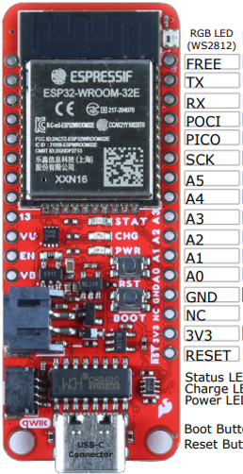
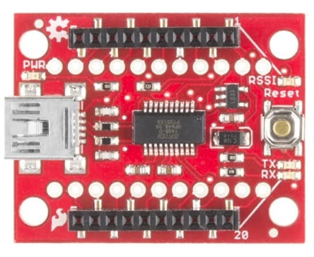
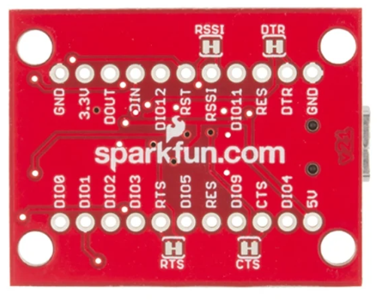
Task 2 – Connect XBee to KestrelSAT
The XBee radio communicates with the MCU using a UART (serial communication). UART’s uses two wires for data: TX (transmit line/DOUT on the XBee) and RX (receive line/DIN on the XBee).
Four wire connections are required:
Connect DOUT Pin of XBee (it’s TX pin) to the RX pin on the MCU (Pin 16)
Connect DIN Pin of XBee (it’s RX pin) to the TX pin on the MCU (Pin 17)
Connect GND of the XBee to universal ground (i.e. the same ground connected to all other devices).
Connect 5V of the Xbee to the 5V rail.
After the carrier board is connected, install an XBee with dipole antenna on your KestrelSAT. Do not swap out this XBee for the remainer of this lab.
Intro
Reference
Task 1
Task 2
Task 3
Task 4
Task 5
Turn-in Reqt’s
5V
XBee TX
(To MCU RX / Pin 16)
USB Connector
XBee RX (To MCU TX / Pin 17)

Slide 14
Task 3 – Program KestrelSAT & Test Link
Error 2 during upload of code to your MCU?
Try holding down the boot button on the MCU and re-uploading.
Intro
Reference
Task 1
Task 2
Task 3
Task 4
Task 5
Turn-in Reqt’s
Download the lab code from Teams or instructor USB.
Upload the code to KestrelSAT using PlatformIO.
Unplug KestrelSAT from your laptop and power it on via the onboard battery.
Connect the ground station Xbee with PCB antenna to your laptop and open a serial connection to it using KestrelSAT Ground station GUI.
**Make sure to select correct COMPORT and 9600 for Baud Rate**
KestrelSAT responds to the following commands:
1 → help
2 → get RSSI
3 → toggle LED
(ex) Send 3 to turn the LED on or off.
(ex) Send 2 to get XBee’s current RSSI.
(5) Confirm that toggling the LED and getting RSSI works correctly.
XBee USB not recognized by your computer?
Follow the directions to install FTDI Drivers here
LED

Slide 15
Task 4A – Gather RSSI Data (PCB antenna)
Take KestrelSAT and the ground station outside.
Collect RSSI values at the following distances:
Next, continue moving KestrelSAT farther away from the ground station. Periodically take a RSSI measurement and toggle the LED. Record the distance for each measurement (count Terrazzo tiles). Continue until you can no longer get consistent RSSI values. Note you may be able to go farther and still toggle the LED (why?).
Intro
Reference
Task 1
Task 2
Task 3
Task 4
Task 5
Turn-in Reqt’s
Distance (m) | RSSI (dBm)
0.5
1
2
5
Distance (m) | RSSI (dBm)

Slide 16
Task 4B – Gather RSSI Data (dipole antenna)
Intro
Reference
Task 1
Task 2
Task 3
Task 4
Task 5
Turn-in Reqt’s
Repeat Task 4A using an XBee with a Dipole antenna on your ground station instead of the PCB antenna used previously.
At or near max reliable range, try turning one of the dipoles so it is perpendicular to the other. Record how this affects RSSI.
Distance (m) | RSSI (dBm)

Slide 17
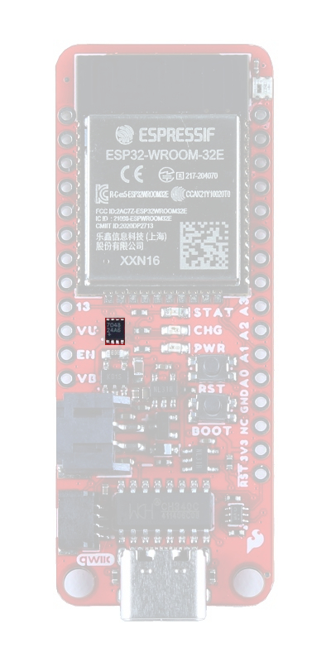
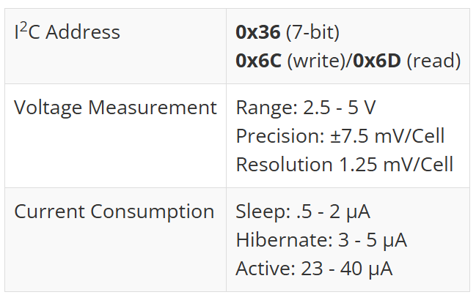
Task 5 (optional but recommended)
In this recommended task, you’ll add code to send the battery information over the telemetry connection when queried by the ground station.
The ESP32-WROOM Thing Plus MCU contains a MAX17048 fuel gauge I2C sensor capable of measuring the approximate charge or discharge rate, state of charge (SOC) (based on Model Gauge algorithm), and voltage of a connected battery.
Intro
Reference
Task 1
Task 2
Task 3
Task 4
Task 5
Turn-in Reqt’s
Add code to utilize the MAX17048 onboard the ESP32-WROOM Thing Plus MCU to measure discharge rate, state of state of charge, and battery voltage.
Add a new telemetry response so that when the ground station Xbee sends a ‘4’, KestrelSAT responds with the information from Step 1.
Demonstrate this new functionality to your instructor.
MAX17048 fuel gauge

Slide 18
Turn-In Requirements
Authorized Resources - POSTLAB
Postlab turn-in is individual effort
Generative AI Level 0 Allowed (GenAI not allowed)
Astro 331 course notes/ instructor
Intro
KestrelSAT
Reference
Task 1
Task 2
Task 3
Task 4
Task 5
Turn-in Reqt’s
For this lab, you’ll complete a Postlab analysis of your RSSI data, comparing it to theoretical predictions of RSSI.
For your calculations, use values from Reference – Digi Xbee3 Performance Specs slide (refer to XBee 3, not XBee 3-PRO).
Write a script to predict the link margin for each setup (KestrelSAT w/ PCB antenna & KestrelSAT w/ dipole antenna) across ranges from 0.5m to 100m past the longest range you recorded RSSI for. Generate a well formatted and labeled plot showing these two curves (range on X-axis, link margin on Y-axis).
Add the RSSI data points you recorded for each setup to the plot.
Comment on differences between the predicted and actual RSSI for each setup. Discuss potential reasons for differences.
During your Task 4B testing, what differences in RSSI did you note when you turned one antenna to be perpendicular to the other? Is this what you expected (explain)?
Assume KestrelSAT is in a 200 km circular orbit. Calculate the worst-case link margin given dipole antennas on both ground station and KestrelSAT and minimum elevation angle of 15 degrees. Assume there is no polarization loss. Is this link margin sufficient for successful data transfer? If not, how might you make it sufficient? Don’t just say “increase gain or power”—discuss downsides of each method, and/or source actual components you could substitute in to improve the link margin.
Turn-In Format
Provide answers digitally.
Math work may be handwritten.
Include a documentation statement.

Slide 19
Deprecated Slides
(For reference only)
Notes:
Old Prelab Report Guidance: https://www.overleaf.com/read/vzjvwdkjhvrh#5be3f8 ← DEPRECATED (DO NOT USE, FOR INSTRUCTOR REFERENCE ONLY)

Slide 20

Reference – PuTTY
Intro
KestrelSAT
Reference
Prelab
Task 1
Task 2
Task 3
Task 4
Turn-in Reqt’s
PuTTY is a free, open-source terminal emulator for Windows (also available on Linux/macOS in some forms).
It lets you connect to other devices using several communication protocols, most commonly:
Serial (UART over USB) → talk to microcontrollers, XBee radios, routers.
SSH → securely log into remote Linux machines (like Raspberry Pi).
Telnet / Raw / Rlogin → older protocols, rarely used today.
Think of PuTTY as the window between your PC and your device’s serial/command line interface.
It’s like the Serial monitor available in the Arduino IDE, but with more features.
For this lab we’ll be using a portable (no install required) version of PuTTY, available on Teams.

Slide 21
Prelab Tasks
Intro
KestrelSAT
Reference
Prelab
Task 1
Task 2
Task 3
Task 4
Turn-in Reqt’s
(1) Complete the Prelab Report per the instructions here:
https://www.overleaf.com/read/fjwgcgrknrph#81580d
(2) Read and understand the Reference slides of this document.

Slide 22
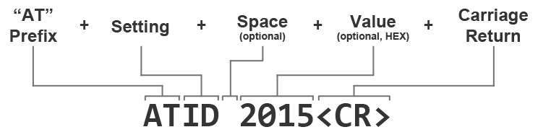
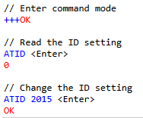
Reference – AT Commands
Intro
KestrelSAT
Reference
Prelab
Task 1
Task 2
Task 3
Task 4
Turn-in Reqt’s
AT commands (short for Attention commands) are a simple text-based way to configure and control modems or radio modules.
The letters “AT” tell the device to pay attention to the next command.
After “AT”, you type short codes that change settings or ask for information.
How it Works with XBee
Enter command mode:
Type +++ (with a 1-second pause before and after) to switch the XBee from data mode into command mode. → The module replies with OK.
Send AT commands:
Example: ATID 1234 → sets the PAN ID (network ID).
Example: ATVR → asks for the firmware version (module replies with the number).
Exit command mode: Type ATCN to go back to normal data mode or Xbee’s exit command mode after 10 seconds without receiving a command.
Why Use AT Commands?
Easy setup: No special software required, just a serial terminal.
Quick testing: You can directly change settings and confirm they work.
Learning tool: AT commands expose the same configuration parameters that matter in larger communication systems (frequency, addresses, baud rate, power levels, etc.).
Reference

Slide 23
Reference – Common AT Commands
Intro
KestrelSAT
Reference
Prelab
Task 1
Task 2
Task 3
Task 4
Turn-in Reqt’s
Command | Meaning | Example | Notes
+++ | Enter command mode | +++ | Wait ~1 sec silence before and after; reply = OK
ATCN | Exit command mode | ATCN | Returns to normal (transparent) mode
ATID | Set / read PAN ID (network ID) | ATID 1234 | Modules must share the same PAN ID to talk
ATMY | Set / read my address | ATMY 1 | Unique ID for each module in the network
ATDL | Set / read destination address (low) | ATDL 2 | The address of the device you want to talk to
ATDH | Set / read destination address (high) | ATDH 0 | Usually 0 for point-to-point setups
ATCH | Set / read RF channel | ATCH 0C | Must match between modules (hexadecimal)
ATVR | Read firmware version | ATVR | Useful to check module details
ATBD | Set / read UART baud rate | ATBD 3 | 3 = 9600 baud; both ends must match
ATWR | Write settings to non-volatile memory | ATWR | Saves changes so they persist after reset
ATRE | Restore defaults | ATRE | Handy if you get “stuck”

Slide 24
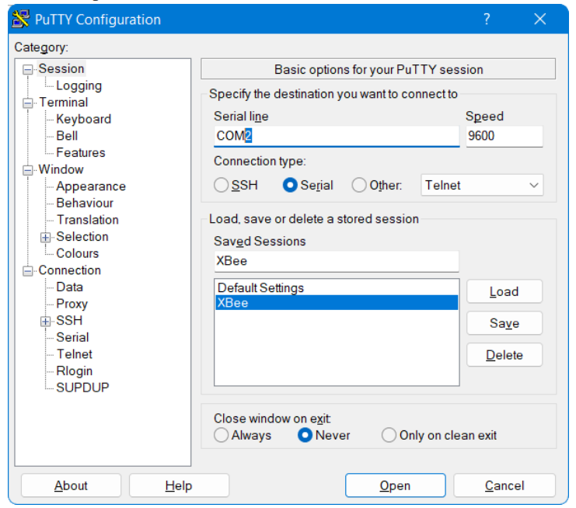
Task 1 (1/2) – Configure XBee Radios
In this task you’ll Pair your radios. Your radios must be configured with matching parameters.
Complete this task three times-once for each radio.
Intro
KestrelSAT
Reference
Prelab
Task 1
Task 2
Task 3
Task 4
Turn-in Reqt’s
Connect a XBee breakout board to your computer via USB.
Download PuTTY serial terminal folder from Teams and open PuTTYPortable.exe.
Configure PuTTY settings and connect to Xbee
- Select 'XBee’, click ‘Load’
- Select 'Serial'
Change 'COM#' to the correct number (look at device list in Arduino IDE to determine radio's COM number)
- Click ‘Open’

Slide 25
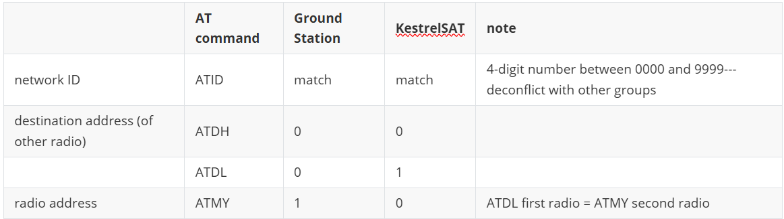
Task 1 (2/2) – Configure XBee Radios
To configure a radio, you must enter AT command mode.
**When entering data into a serial terminal, DO NOT TYPE BACKSPACE. The backspace key counts as a key and does not delete the previous keystroke. If you make a mistake, wait and try again.**
To enter command mode:
- type nothing for 1 second
- type `+++` (DO NOT press Enter)
- type nothing for 1 second
The connected radio will reply `OK`. You are now in command mode. Command mode will timeout after 10 seconds of inactivity.
Intro
KestrelSAT
Reference
Prelab
Task 1
Task 2
Task 3
Task 4
Turn-in Reqt’s
4. Enter command mode.
5. Enter relevant configuration commands (see table below).
NOTE: **DO** press `Enter` after entering an AT command.

